Slide 1
Data Science
CSE-4075
(k-means)

Slide 2
Partitional Clustering
Output a single partition of the data into clusters
Good for large data sets
Determining the number of clusters is a major challenge

Slide 3
K-Means
Predetermined
number of clusters
Start with seed
clusters of one
element
Seeds

Slide 4
Assign Instances to Clusters

Slide 5
Find New Centroids

Slide 6
New Clusters

Slide 7
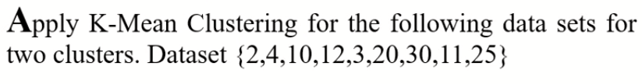
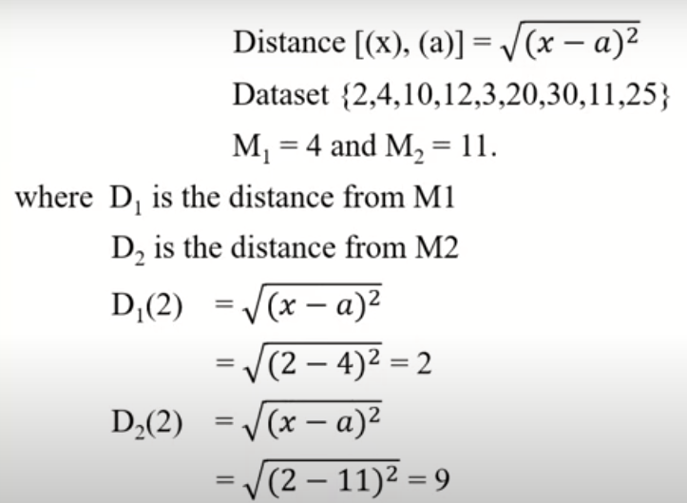
Example

Slide 8
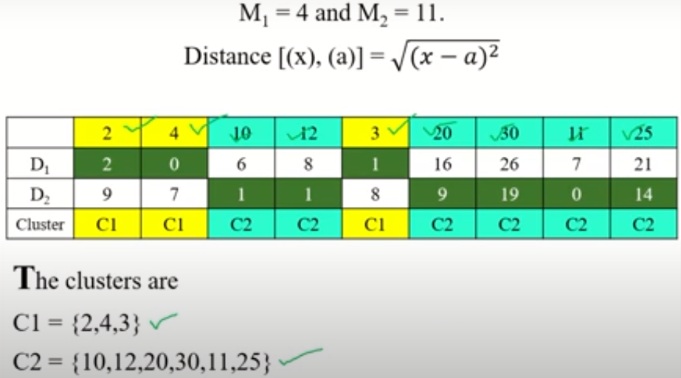
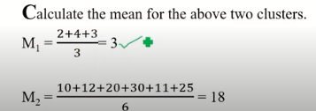
Example

Slide 9
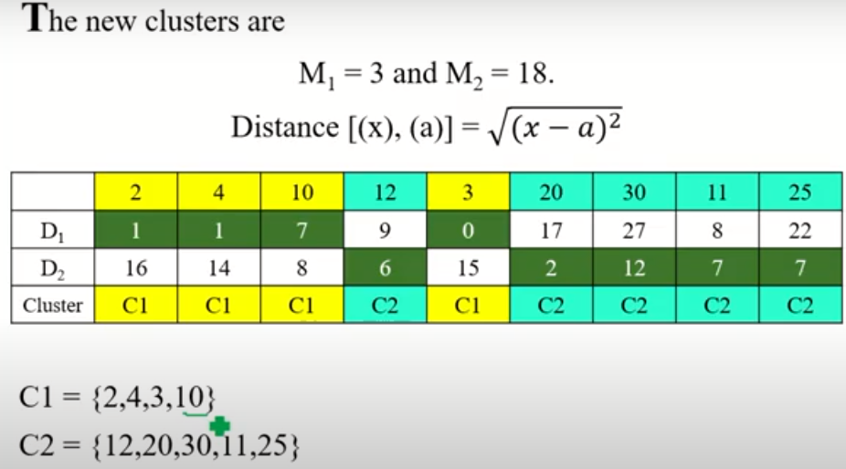
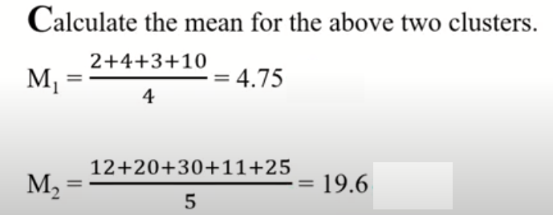
Example

Slide 10
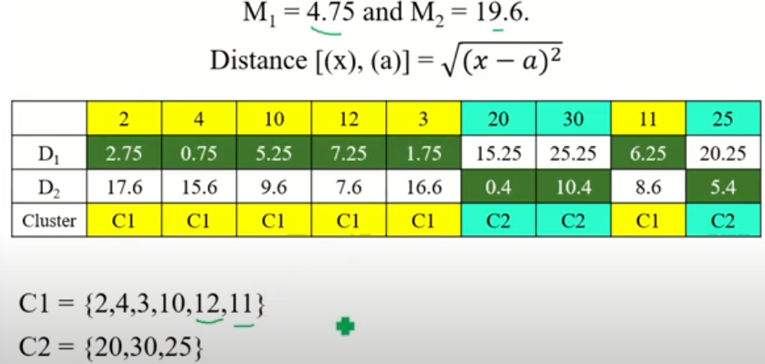
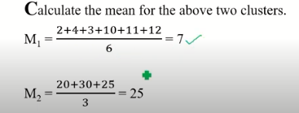
Example

Slide 11

Example
Repeat if for the next iteration and check whether the clusters remain the same or not?

Slide 12
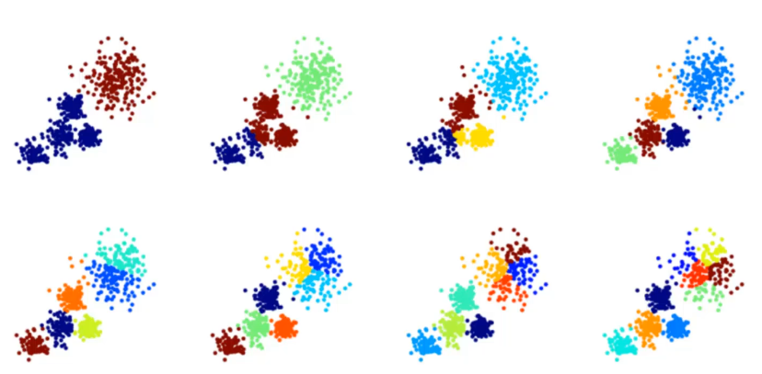
Choosing the Value of k

Slide 13
Choosing the Value of k
There is no easy way to choose the value of K
One way is the elbow method
First, compute the sum of squared error (SSE) for some values of k (for instance 2,4,6,8 etc.)
The SSE is defied as the sum of the squared distance between each member of the cluster and its centroid

Slide 14
Choosing the Value of k
If you plot k against SSE, you will see that the error decreases as k gets larger; this is because when the number of clusters increases, they should be smaller, so distortion is also smaller
The idea of elbow method is to choose the k at which the SSE decreases abruptly

Slide 15
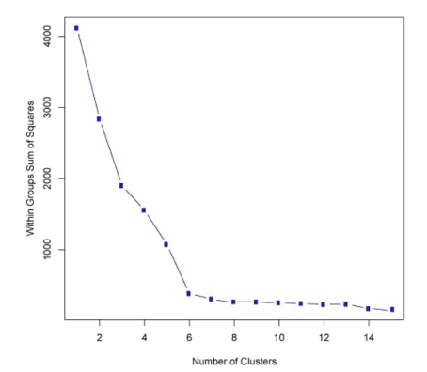
Choosing the Value of k

Slide 16
Strengths of k-means
Strengths:
Simple: easy to understand and to implement
Efficient: Time complexity: O(tkn),
where n is the number of data points,
k is the number of clusters, and
t is the number of iterations.
Since both k and t are small. k-means is considered a linear algorithm.
K-means is the most popular clustering algorithm.
Note that: it terminates at a local optimum if SSE is used. The global optimum is hard to find due to complexity.

Slide 17
Weaknesses of k-means
The algorithm is only applicable if the mean is defined.
For categorical data, k-mode - the centroid is represented by most frequent values.
The user needs to specify k.
The algorithm is sensitive to outliers
Outliers are data points that are very far away from other data points.
Outliers could be errors in the data recording or some special data points with very different values.

Slide 18
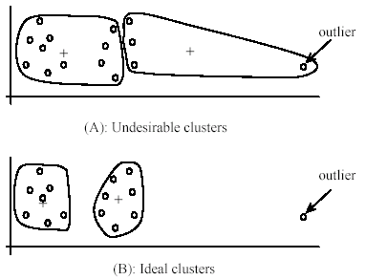
Weaknesses of k-means: Problems with outliers

Slide 19
Weaknesses of k-means: To deal with outliers
One method is to remove some data points in the clustering process that are much further away from the centroids than other data points.
To be safe, we may want to monitor these possible outliers over a few iterations and then decide to remove them.
Another method is to perform random sampling. Since in sampling we only choose a small subset of the data points, the chance of selecting an outlier is very small.
Assign the rest of the data points to the clusters by distance or similarity comparison, or classification

Slide 20
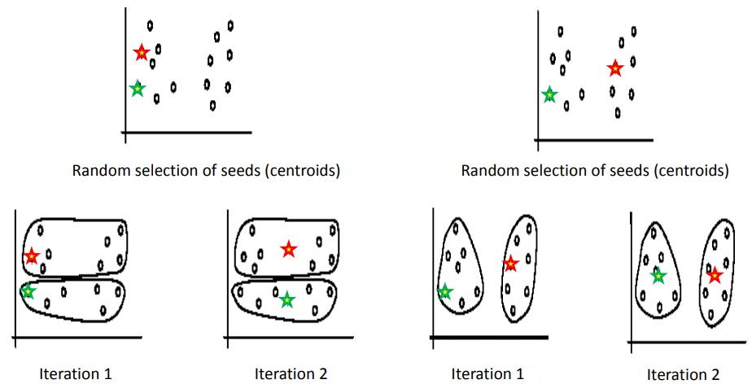
Weaknesses of k-means: Sensitivity to initial seeds

Slide 21
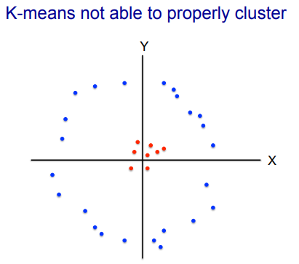
Weaknesses of k-means: Can’t handle each type of data

